Slide 1

Predicting if a video game will succeed after launch
Omer Gez Daniel Israelov

Slide 2
background
The video games industry is growing bigger and bigger each year.
Every studio/developer wants to increase its sales and reach out to more gaming communities and gamers.
The “war” between the developers takes place mostly on YouTube and E3 expo^{[4]} where they reveal game teasers, trailers, and gameplay exhibitions.
YouTube can be a great place to approximate if a game will be successful because of the likes, views, and comments of gamers. By viewing and analyzing this data, the developers can see what gamers think about the upcoming game and act accordingly.
Doom 4^{[5]} is an example of a game whose development was canceled due to negative comments and feedback.

Slide 3
Idea of the project
Can we predict if a newly published video game will be successful or not, based on user and professional factors?
Can we analyze certain factors that would help determine the success of a video game?

Slide 4
Process
Step 1 – Data acquisition (API and crawling)
Step 2 – Data handling
Step 3 – EDA (visualization and statistical tests)
Step 4 – Machine learning
Step 5 – Conclusion

Slide 5
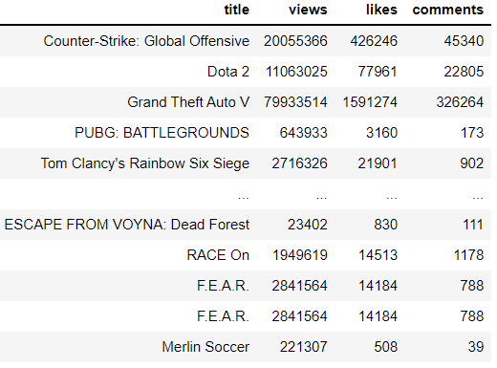
Data acquisition
To build the Data Frame, we used the following: - API from YouTube^{[1]} and SteamSpy^{[2]}
- Crawling on YouTube and Metacritic^{[3]} using
both Selenium and Beautiful Soup.
YouTube data frame

Slide 6
Data acquisition
Website | Packages | Raw data size
YouTube | Selenium API Pandas urllib | 20K
SteamSpy | API Pandas Json requests | 85K
Metacritic | Selenium BeautifulSoup Pandas | 24K

Slide 7
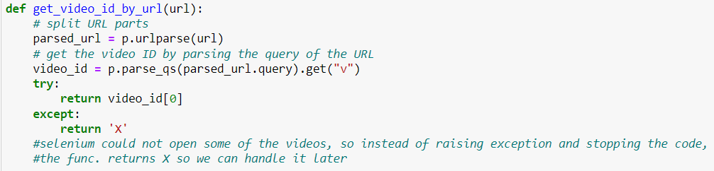
Youtube
To acquire data from YouTube we used both Selenium and YouTube’s API.
The first step was to create a list of video game names we got from SteamSpy.
After that, we started searching YouTube for the official trailers of every game on that list. (We used Selenium for that).
For each trailer, we broke down the URL to get the video ID.
We used the video ID to get information (Likes, Views, Comments amount) from YouTube’s API.

Slide 8
steamspy
Getting the data from steam spy was a simple API call from the website. However, some columns were irrelevant for our research: appid, score_rank, median_2weeks, average_2weeks, etc.
We collected 5000 rows from the API and saved it as a data frame.

Slide 9
Metacritic
First, we created a list that holds URLs of all games from 2009 to the end of 2021 on the website.
The Second step was to set up a selenium driver to iterate through those URLs and navigate through the pages. For each page, we downloaded the page source.
At the third step, we created a beautiful soup object which contains the page source and scraped the details of all games on the page, and saved it in a dictionary which is used to build a data frame.
Finally – Adding a new column named “score” to the main data frame and iterating through both main and Metacritic data frames to match the game’s name and assign the relevant score to that game.

Slide 10
Selenium Code snippet
Metacritic
YouTube

Slide 11

Important columns
Score – Taken from Metacritic website. The values in this column were given by professional video game critics. For this research, the “Score” column is considered the most significant and we compare it to the rest of the data for correlation and statistical tests.
Is_successful – Self-created to check our prediction (with machine learning algorithms). This column has binary values (0 or 1) when ‘1’ signifies success and ‘0’ signifies the opposite.
Based on the “Score” column: A Game with a score of 75 or higher is 1. A game with a score of less than 75 is 0.

Slide 12
Data handling
SteamSpy - There were some NaN values in the ‘publisher’ and ‘developer’ columns. Instead of dropping those rows, we copied the ‘developer’ name into the ‘publisher’ and vice versa. By doing that we saved ~30 rows (~360 data). Also, we dropped duplicates and special edition games.
‘price’ values were converted from cents to dollars. (For better visualization).
‘owners’ values was a range of owners so we replaced it with the average of that range and change the column name to ‘owners_approx.’
Some games were not on the Metacritic site. To handle their ‘score’ value we used the ‘positive’ and ‘negative’ values which represent the amount of positive and negative feedback (from SteamSpy).
Outliers – we discovered some values that could be outliers, but after further investigation, we found out that the values are correct and should not be handled.

Slide 13
EDA and statistical tests
First part was to visualize the numeric columns with a bar plot. We also scaled each column to better understand the distribution.
Second part was to check correlations between the ‘score’ column and the rest of the numeric columns. Since none of the columns had a normal distribution, we used the Spearman method. We presented both the scatter plot between score and other columns and the actual correlation value between said columns.
Statistical tests – We used T-Test in three ways:
T-Test with 1 sample.
T-Test with 2 samples.
T-Test between 2 columns.
Those with a P-value below 0.05 had their null hypothesis rejected and those above 0.05 failed to be rejected. Both the rejected and failed-to-reject columns were added to a corresponding list.

Slide 14
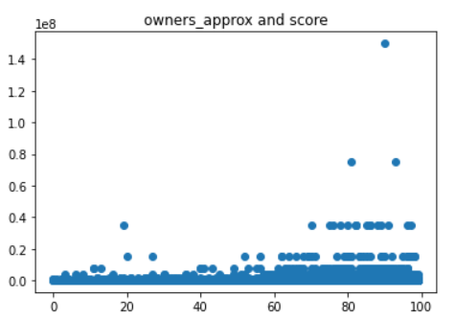
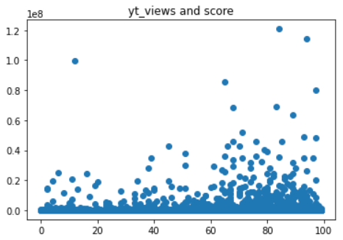
Visualizations
We can see that a game score (x-axis) has some effect on the market.
A higher score leads to more units sold.
More YouTube views (y-axis) can lead to a bigger hype which can lead to a higher score.
* More visualizations in our Jupiter notebook on GitHub.

Slide 15
Machine learning
In the ML phase we used the supervised approach.
The feature vector (X) contained all the numeric columns, not including the ‘is_successful’ and ‘score’ columns(‘is_successful’ is the target column (y)).
We trained the model using Logistic regression which is used especially for binary problems (in our case – 0 or 1).
The prediction was quite impressive – 3837 correct predictions out of 4486 (~85%).
Finally we split the data frame to train and test and compared the measures between unscaled, MinMax and Standard scaled data frames, and compared the confusion matrices.

Slide 16
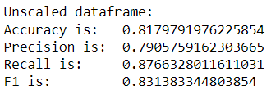
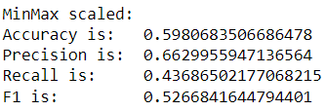
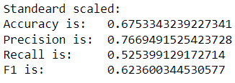
Machine learning
Our main approach was logistic regression on an unscaled model which resulted in a pretty good accuracy – 83%.
Then we tried to scale the set to find out if we can improve the accuracy, but after scaling using MinMax scaler the accuracy dropped to 53%, and after using Standard scaler the accuracy dropped to 62%.
We will stay with the unscaled model.

Slide 17
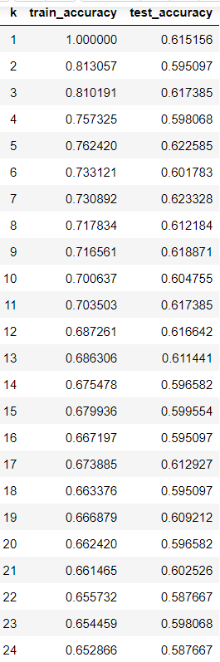
knn
We also tried the KNN algorithm to see if this method will result in better accuracy.
When we used the KNN algorithm, the precision was much lower.
First, we tried with k=3 and got an accuracy of 61%.
After that, we tried various k values ranging from 1 to 24, and as the k value got higher, the train set accuracy got lower.

Slide 18
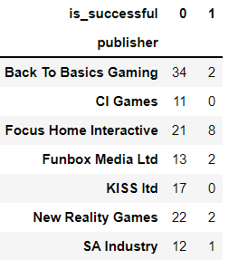
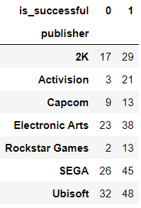
conclusion
In conclusion, the unscaled model has very satisfying results.
Even though the MinMax and Standard scaled models have excellent accuracy, we can’t rely on that because it may be because of overfitting. We manage to find a relation between most of the features to a game’s success.
Some extra findings: We selected by random few well-known and unknown publishers and found that bigger publishers tend to succeed even though they failed many times. On the other hand, unknown publishers tend to fail most of the time.
(This was not part of our research!).
Unknown
Known

Slide 19
references
[1] - https://www.youtube.com
[2] - https://steamspy.com
[3] - https://www.metacritic.com
[4] - https://e3expo.com
[5] - https://www.digitaltrends.com/gaming/the-most-famous-canceled-video-games/

